Slide 1
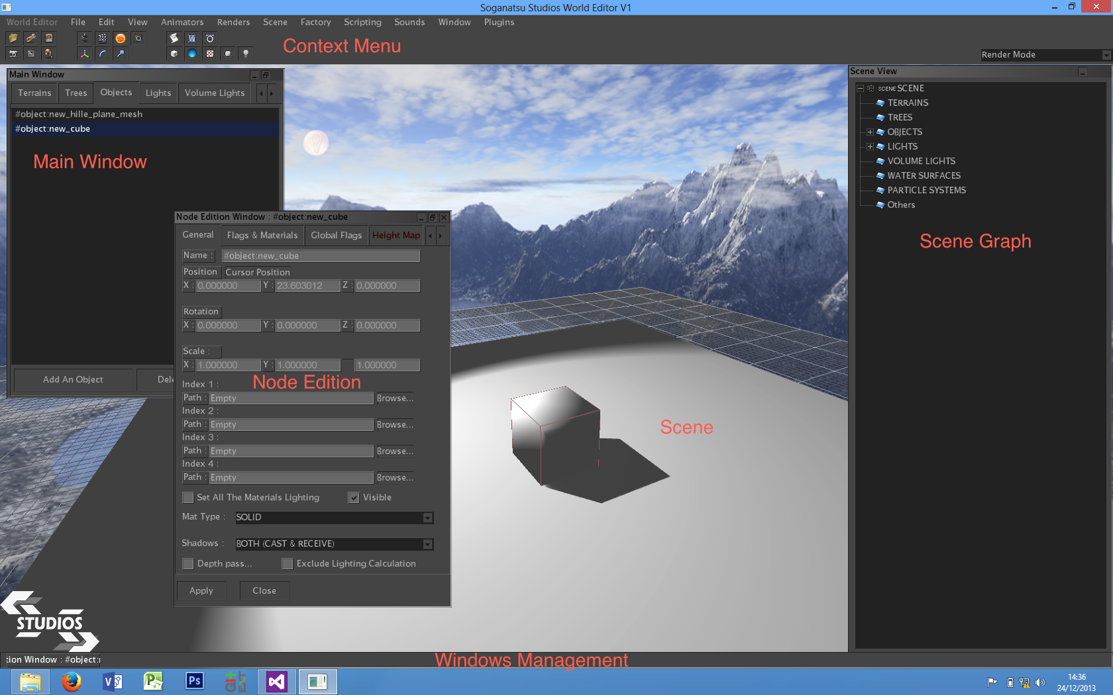
Summary

Slide 2
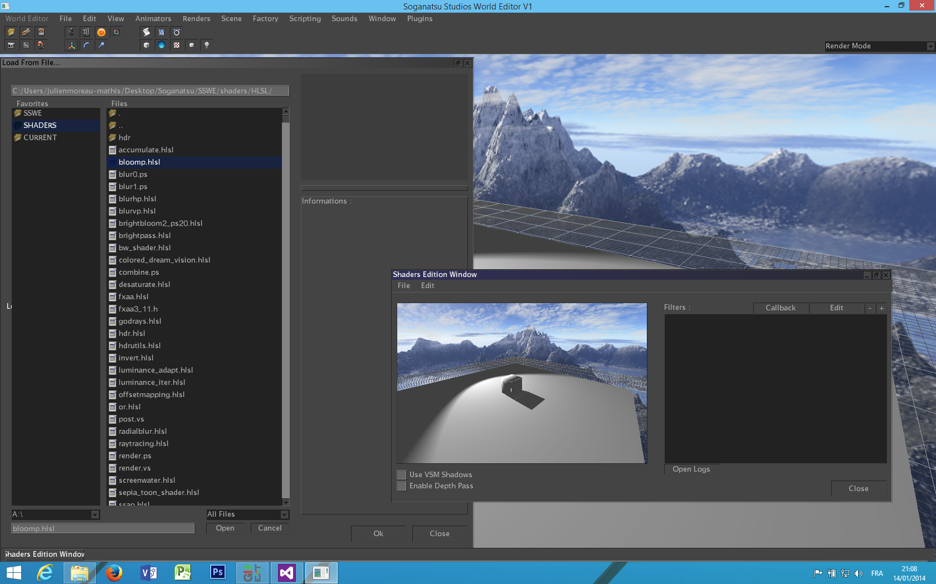
Add a filter
Select the file
Open filters manager
File -> Load from file

Slide 3
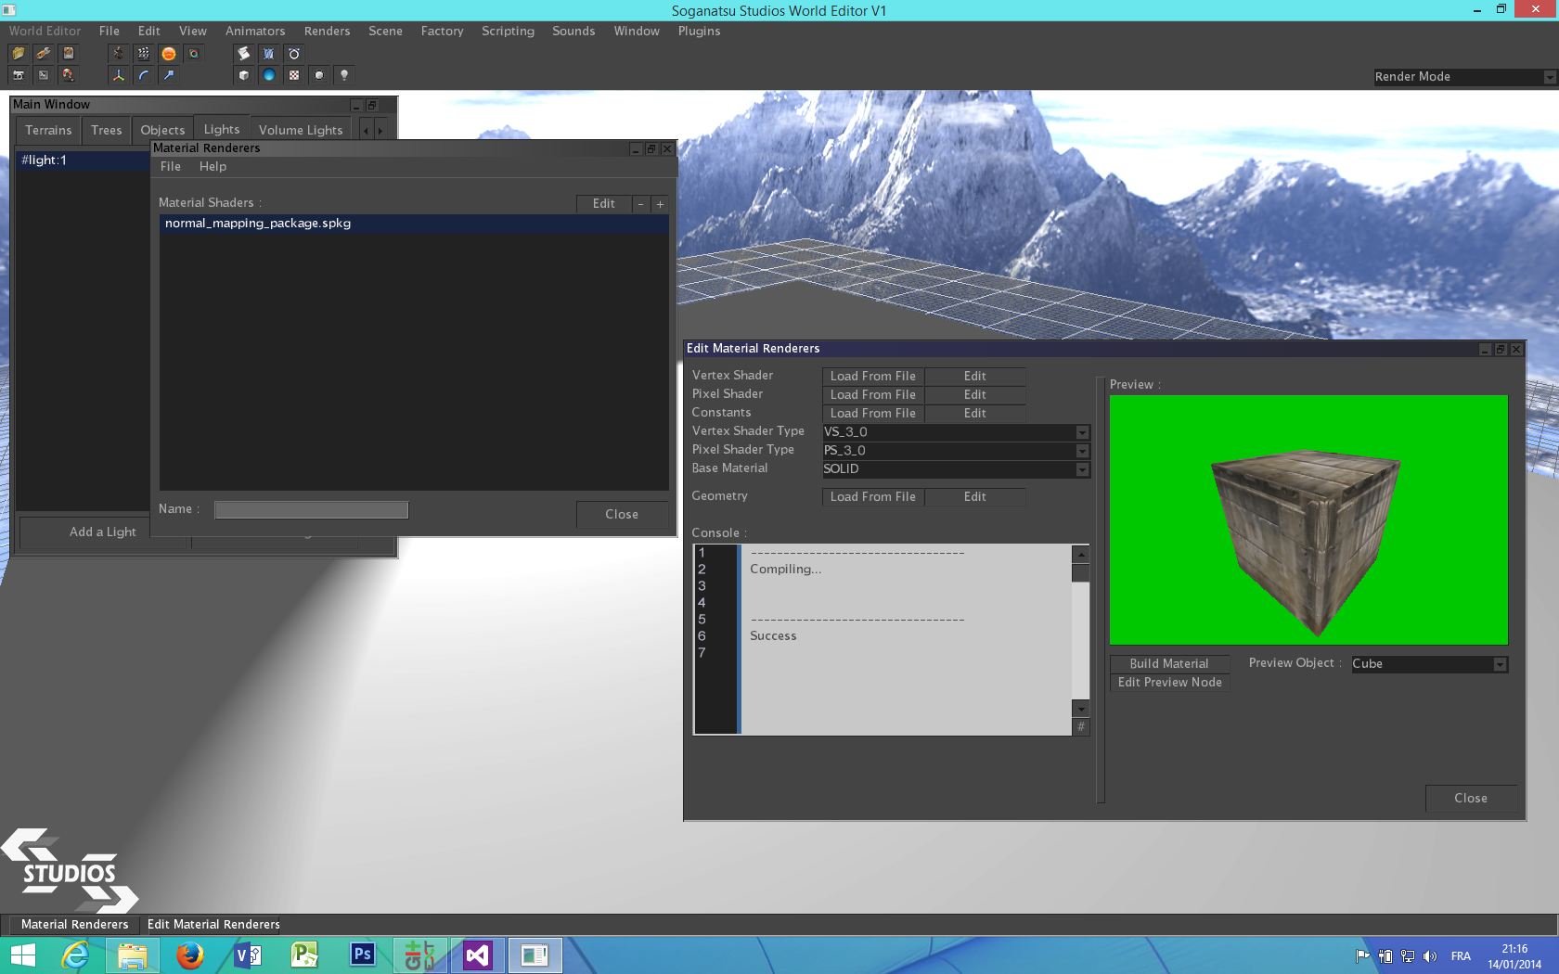
Add a material
Open materials manager
Edit selected material
Edit constants or pixel/vertex shader
Preview
Add from a package (.spkg)
Console
Build material

Slide 4
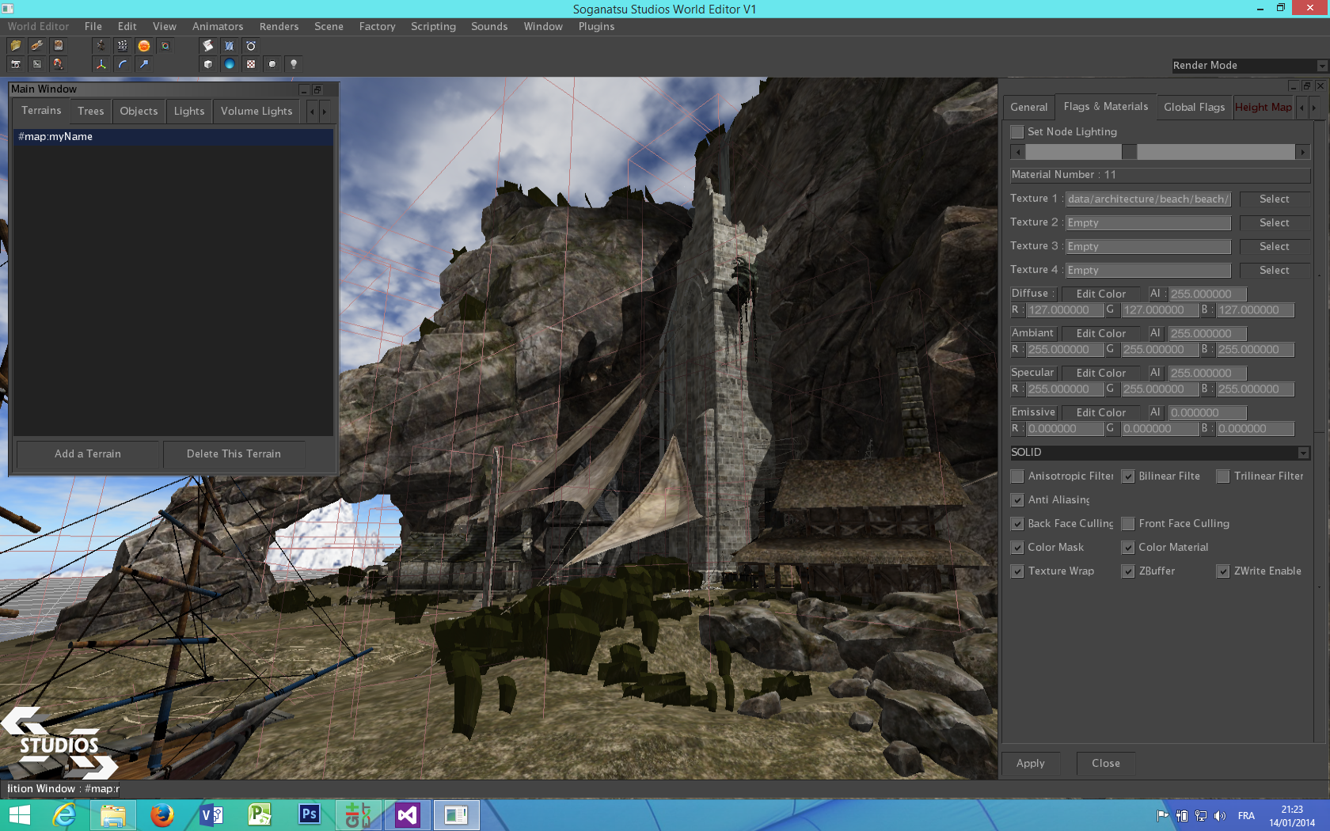
Add a material
Open node edition window
Select node material
Move/rotate/scale selected node
Tabs
Select material type for selected material (can be a custom material shader)
Add a mesh from a file

